Slide 1
EDA Case Study
-Bank Loan
By:- Amit Chawla and Harnoor Singh

Slide 2
Objective -
Analyze the type of clients those apply for loans with the given financial institution
Analyze patterns for determining clients who face payment difficulties
Based on the patterns identified above decide whether a new applicant should be given a loan.

Slide 3
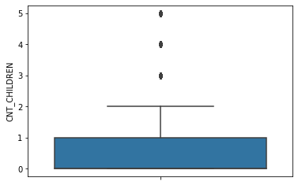
Loan application - Number Of Children
90% of loan applicants have <=2 children.
Only 1 % of the loan applicants have more than 3 children.

Slide 4
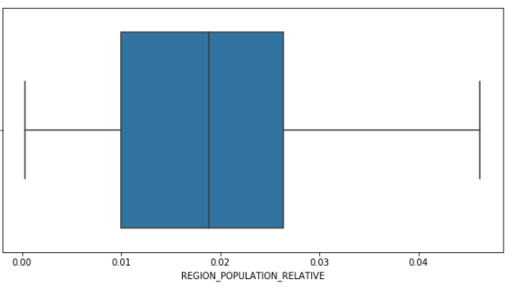
Presence of institution - based on population of region
97.5% of the applicants are from low to medium population density region.

Slide 5
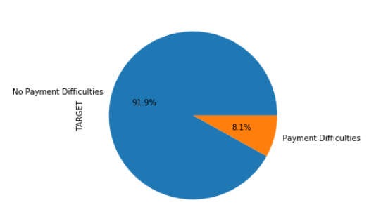
Ratio of payment defaults
91.9% people did not face any payment difficulties while 8.1 % did.

Slide 6
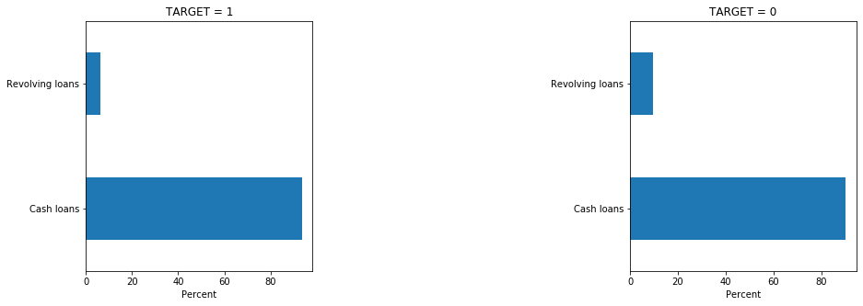
Type of loan and payback
There are slightly more data points for TARGET = 0, where clients had no difficulty in payment for revolving loans. So, clients who opted for revolving loans are slightly more likely to pay back without difficulty

Slide 7
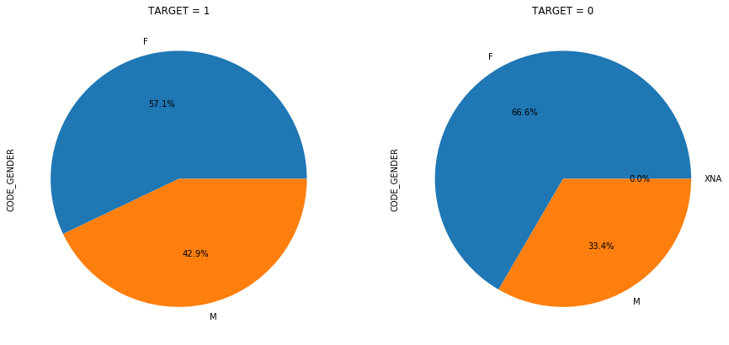
Gender distribution on payment difficulties
For clients who had payment difficulty, around 57% of them whereas females, where males were around 43%.
For clients who had no payment difficulty, around 65% of them whereas females, where males were around 33.5%.

Slide 8
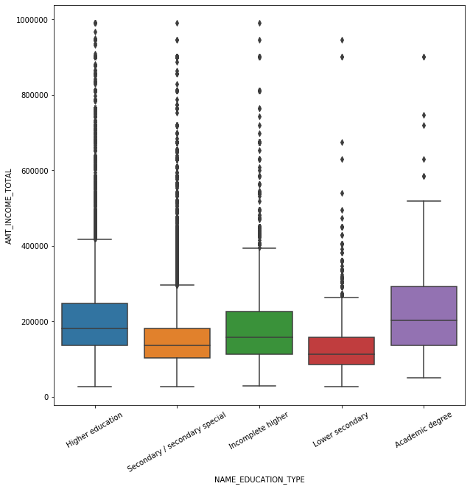
Total Income vs Education Level Analysis
Majority of on time paying clients lies in higher range of AMT_INCOME_TOTAL
Clients with lower secondary who opted for large sum of loan (945000.0) have paid on time while clients of same education who took loans of moderate size (450000.0) have defaulted.
People with NO payment difficulties

Slide 9
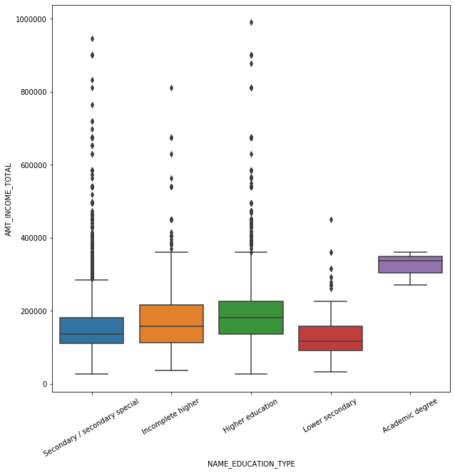
For clients with payment difficulties
Although academic degree seems to be in higher range, there are only 3 cases of default for clients with academic degree and those are in middle income range.
Clients with lower secondary education level are more likely to default for Total Income< 400000
People with payment difficulties

Slide 10
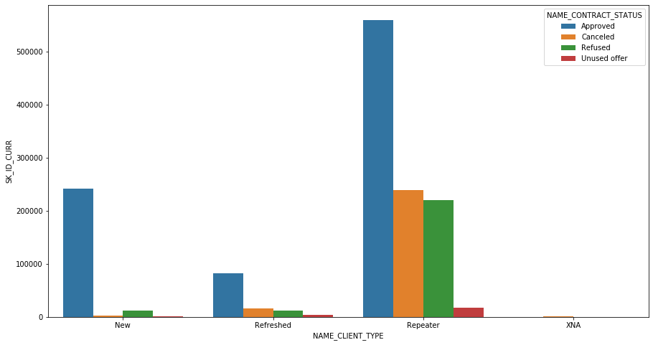
CONTRACT STATUS VS CLIENT TYPE
The count of repeaters is high, clients are loyal to the bank.
The Approved percentage is high for New, Refresher and Repeater. It is significantly higher for Repeater.
Likelihood of new applicants cancelling the application is vey low.
The percentage for Canceled and Refused is also significantly higher for Repeater.
Refreshed clients have slightly higher Canceled percentage as compared to New clients

Slide 11
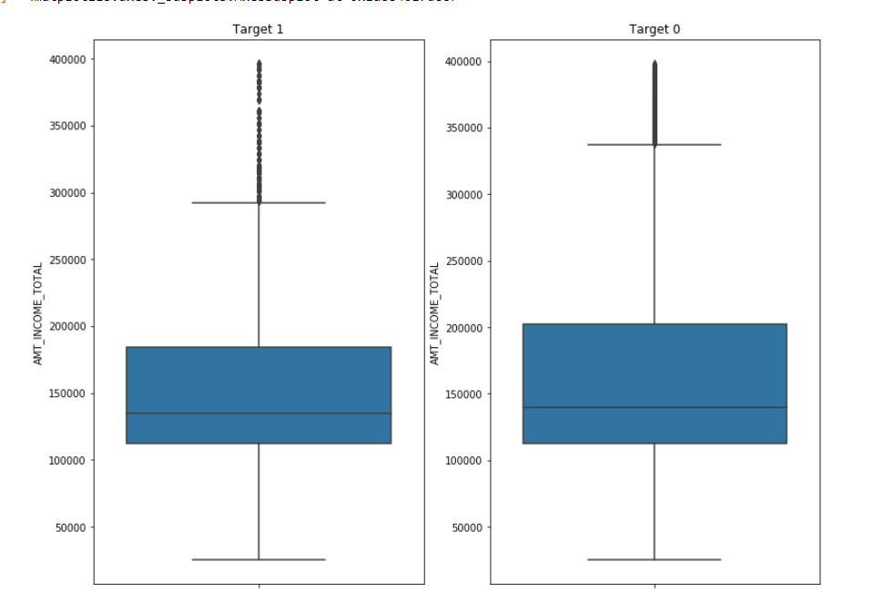
Impact of Income on payment difficulties
For people with income more than 10 lac there is very less risk of default
People with income less than 3 lacs are most likely to face difficulties in payments
More specifically, majority of people who faced difficulties had income between 1 lac and 2 lacs approximately

Slide 12
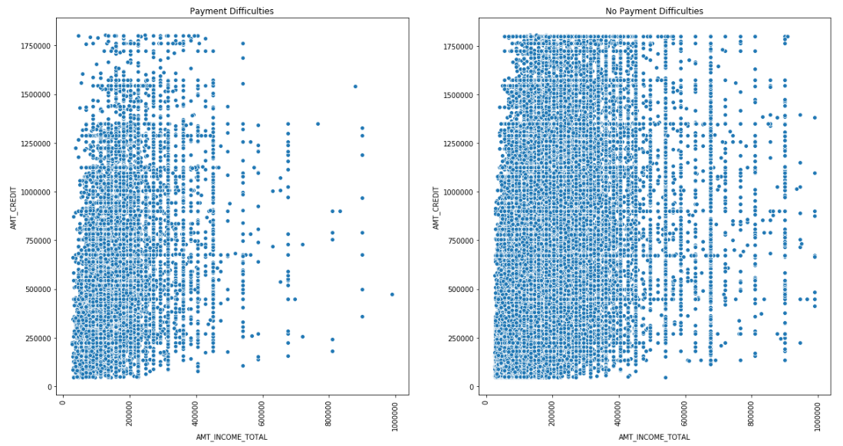
Impact of Income on payment difficulties
Upper limits of the credits in case of people with payment difficulties is less.
Most of the payment difficulties are associated with the people with incomes less than 5 lacs

Slide 13
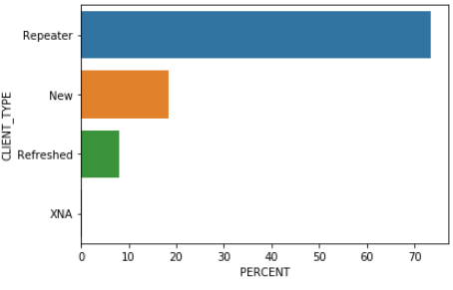
Applicants relation with bank
Most of the applications are from Repeaters.
Clients are loyal to the bank
There are decent New applications too. Hence, the banks might have some attractive offers since it is attracting new applications too

Slide 14
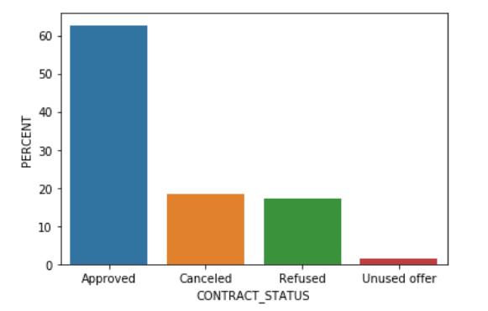
Previous application processing record
62.6% of the previous loan applications were approved.
18.35 % applications were cancelled
Only 17.35% applications were refused.
1.6 % applications were cancelled at some different stages.
Remarks - Bank may want to review the reasons for cancellations of the applications

Slide 15
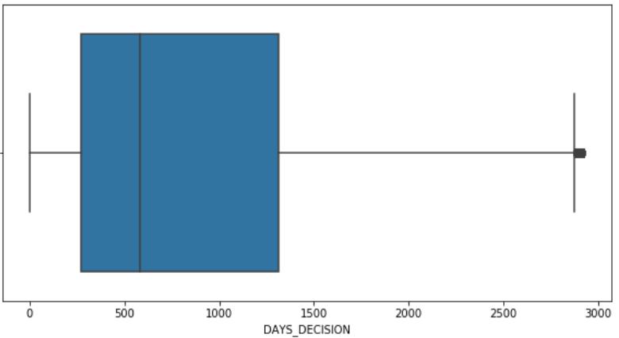
Number of days since last application
### tbd

Slide 16

Highest AMT_APPLICATION loans
We observed that highest AMT_APPLICATION for loan amounted to 58.5 Lacs.
The loan was approved.
Client who applied for this loan has successfully paid back on time without default.

Slide 17
Final Words...
Loan applications are mostly from clients having 0 or 1 children and the loan amount is mostly less than 5 Lakhs.
Females have a high percentage in both, defaulting a loan and paying back on time.
Clients with Lower secondary education level are more likely to default for AMT_INCOME_TOTAL < 400000
The count of Repeaters is high, clients are loyal to the bank
Highest number of people who have applied for loan and defaulted are in age of 25-40 years.

Slide 18
...contd Final Words
Mostly payments are done by cash through the bank by clients.
Very high AMT_APPLICATION (greater than 50 Lac) was approved and the client successfully paid back on time.
For people with income more than 10 lac there is very less risk of default
AMT_CREDIT And AMT_ANNUITY have the highest correlation

Slide 19
Thank you!
By:- Harnoor Singh and Amit Chawla

